Slide 1


Slide 2
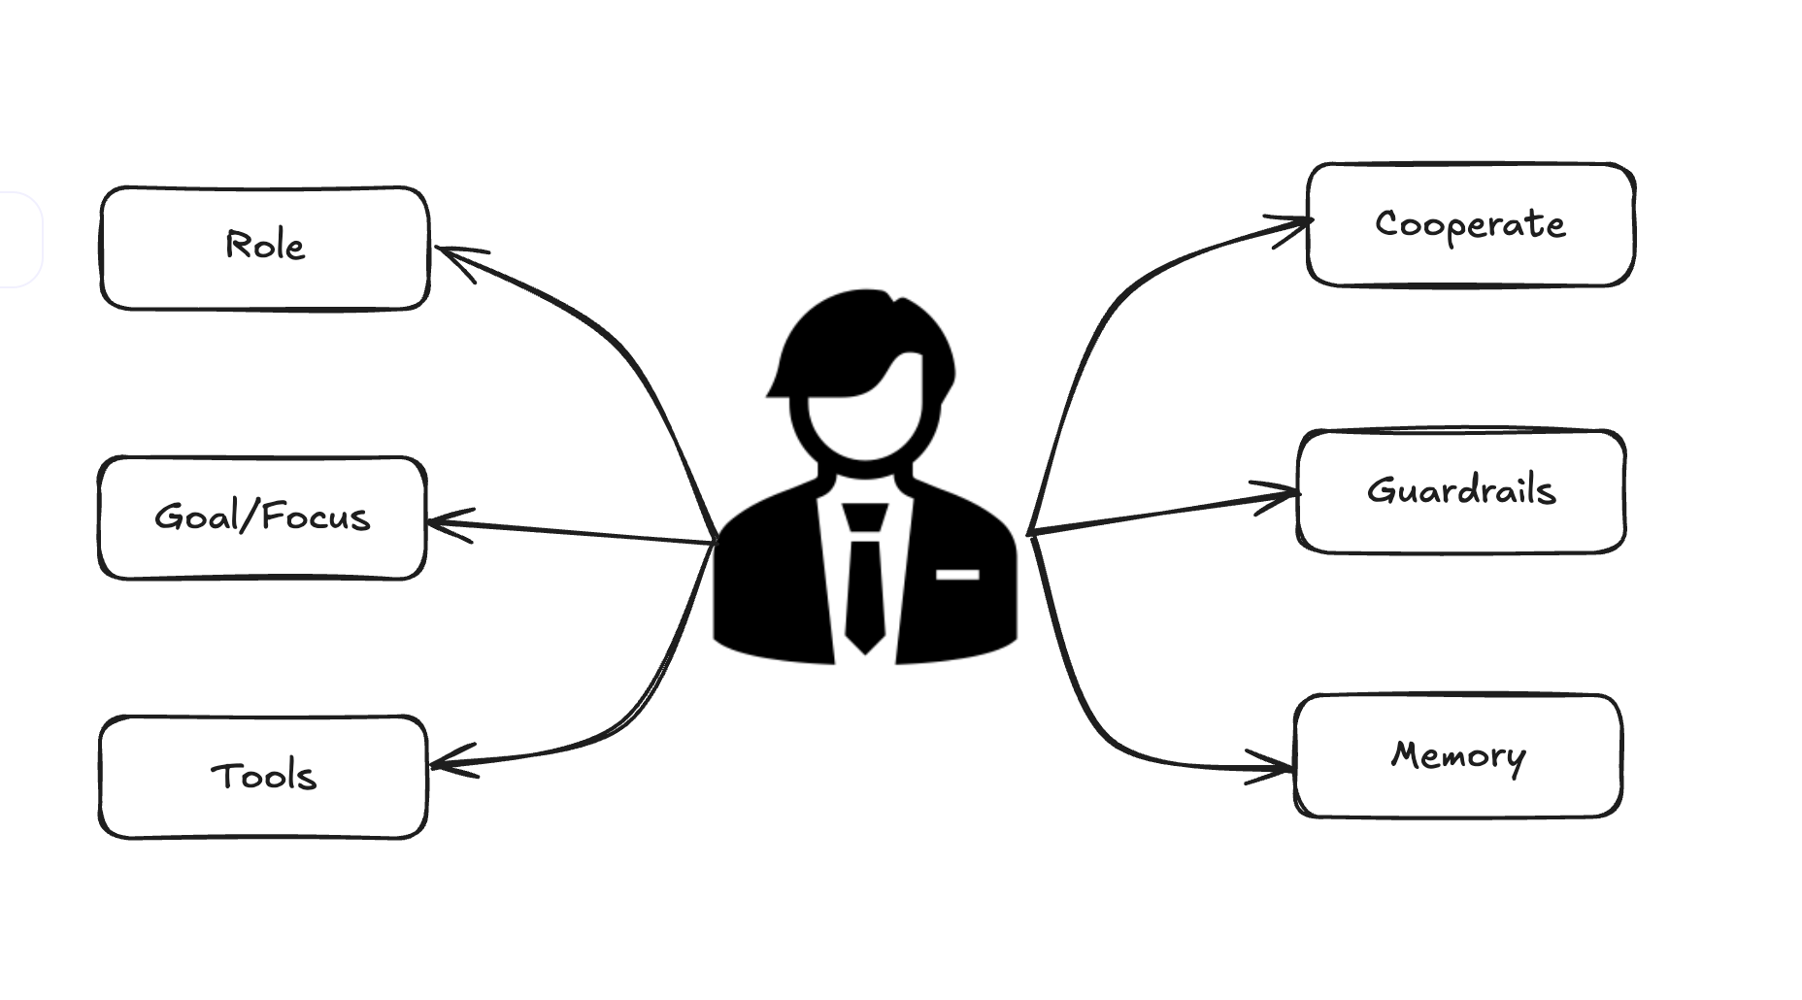
The Human way

Slide 3
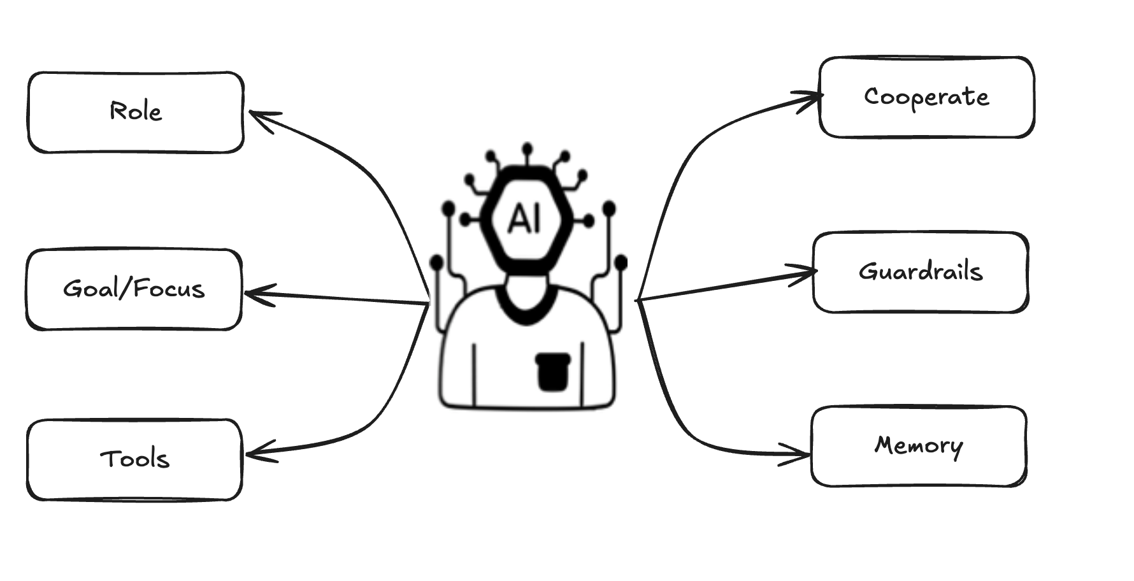
The Agentic AI way

Slide 4
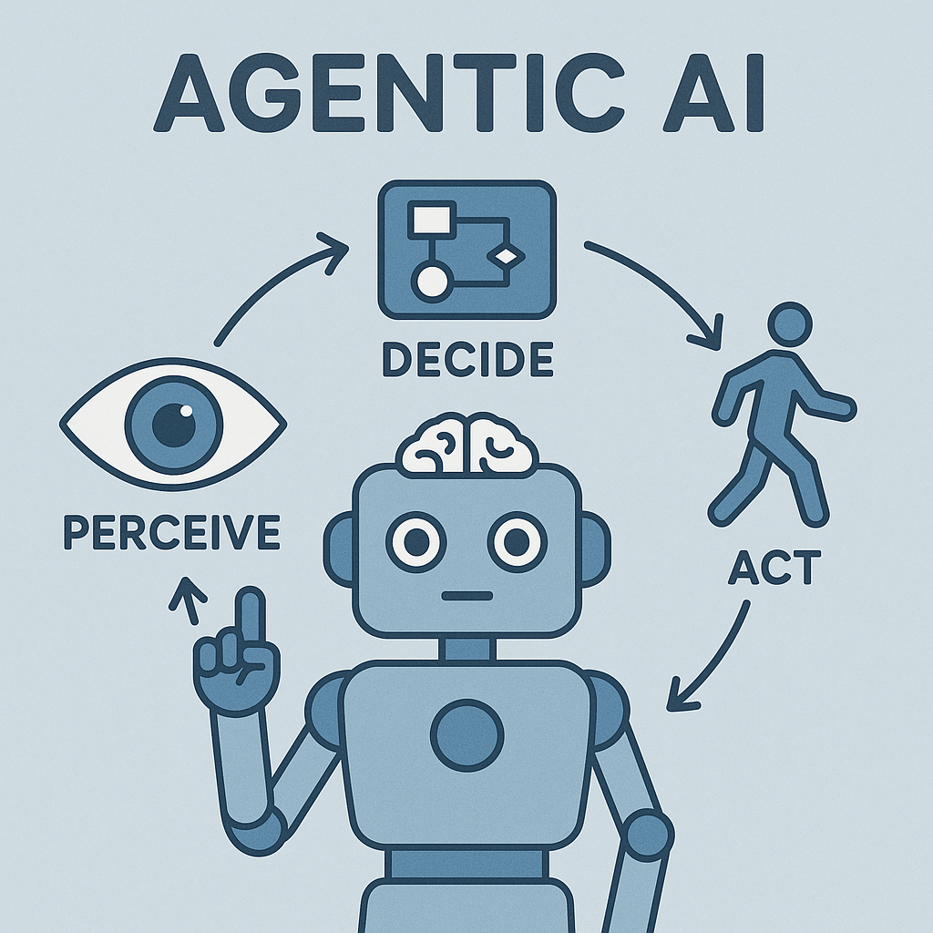
What is Agentic AI
Agentic AI means AI systems that act more like agents: they make decisions, plan actions, react to changes, and work toward goals — almost like little digital employees.
Instead of just answering one question at a time, agentic AI can think, reason, decide, and even call other tools or collaborate with other AIs to complete complex tasks.

Slide 5
Building Blocks of AGENTIC AI
Perception
Reasoning
Action
Learning
It gathers data from its surroundings.
It analyzes this data to identify what it will be used for.
It chooses what to do based on its reasoning.
It improves and adapts over time, learning from feedback and experience.

Slide 6
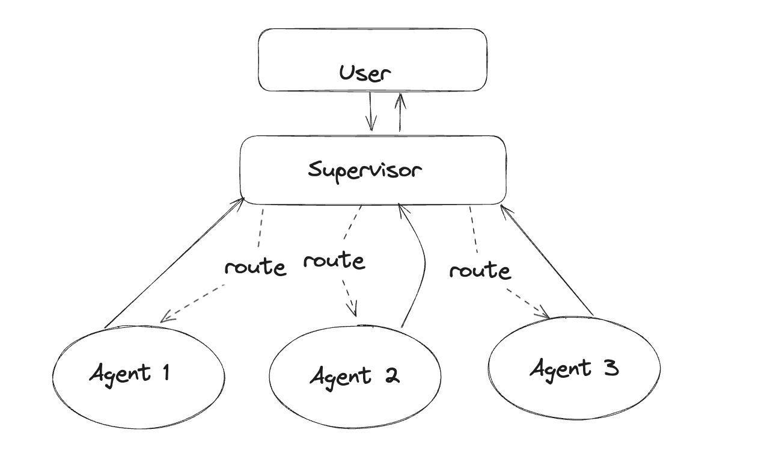
Supervisor Flow

Slide 7
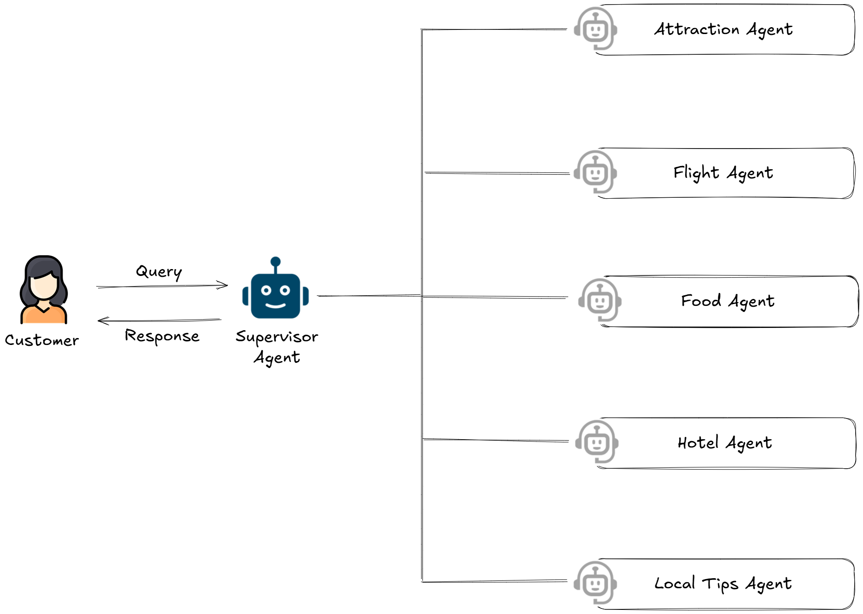
Travel Itinerary Flow

Slide 8
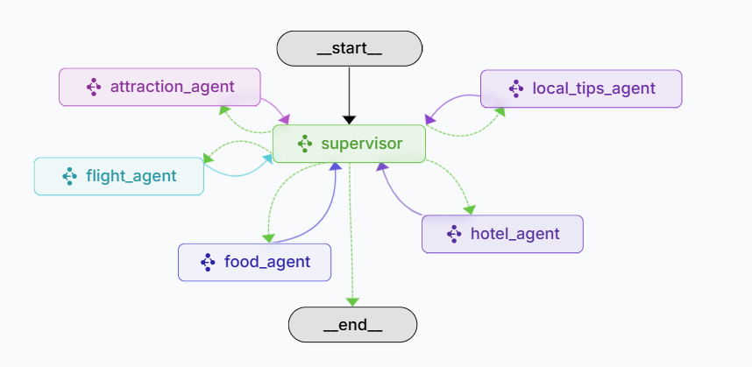
LangGraph Flow
Attraction Agent
Searches local tourist spots to visit in the given destination
Food Agent
Searches for local restaurants to enjoy local food
in the given destination
Local Tips Agent
Gives important travel tips to follow in that destination
Flight Agent
Searches and books rounds flight using Amadeus API for the given travel itinerary
Supervisor Agent
The supervisor agent manages communication and delegates tasks by selecting the appropriate agent based on context and requirements
Hotel Agent
Searches hotels in the specified destination

Slide 9
CREATE REACT AGENT
In LangGraph, `create_react_agent` is a utility that creates a ReAct-style agent capable of reasoning and using tools step-by-step to complete a task. It combines a language model (LLM) with a set of tools, allowing the agent to think (`Thought`), act (`Action`), observe the result, and repeat until it reaches a final answer
TECH STACK
LLM
LANGGRAPH
PYTHON

Slide 10


